Slide 1


TypeScript and Angular 2 an unlikely love story
Presented 9/21/16 to Houston Sharepoint Users Group

Slide 2





About Me
Alex Miller
@amahopa
Likes:
JavaScript
Tea
Long walks in the Redwoods
Dislikes:
Legacy Browsers
Work Relationship Status
I <3
(and get to work there too)
*Opinions and corny jokes are my own and not my employer’s

Slide 3
LOVE

Slide 4


Language of Love

Slide 5

Love is Awesome
Runs almost everywhere
Expressive
First class functions
Object composition

Slide 6

Love is Hard
Which version runs everywhere?
ES3, ES5, ES6
Will let you do almost anything
People miss classes
Runtime errors:
‘undefined is not a function’
Weak Typing System

Slide 7



TypeScript
Static Typing
Interfaces
Generics
Decorators
Mixins
Compile time checks
Compiles to plain ES3, ES5, ES6
ES2015 (ES6)
Classes
Arrow functions
Modules
let & const
Promises
Iterators
Generators ☹
for..of
Symbols
Multi-line strings
Spread operator
Destructuring
ES5 2009
Strict Mode
Array Methods
Object Methods
ES2016 (finalized)
Exponent operator
Array.includes
ES3 1999
Can be used to write Angular 2
http://kangax.github.io/compat-table/es6/

Slide 8

TypeScript - Why?
Intellisense & Code Completion
Errors on Save > Build Errors > Runtime Errors
Use the latest language features
Static Type Checking
Why with Angular2?
Angular2 is written in TypeScript
More & better documentation in TypeScript

Slide 9
Typescript Compiler
Magic

Slide 10

TypeScript Tools
TypeScript Compiler (TSC): many ways to get it…
Visual Studio 2015 (update 2)
Node via NPM
An Exe
Type Definitions Files (.tsd)
Type Definitions for JS libraries, Definitely Typed is a repository of tsd files
Managed via Typings or TSD <- Deprecated
Linting - TSLint
VS Code – Plugin
Visual Studio - Web Analyzer by Mads Kristensen

Slide 11



Slide 12


Slide 13
Code Example
typescriptExample.ts vs typescriptExample.js

Slide 14








Slide 15
Getting Started - Angular CLI
Need Node & NPM installed
Install CLI
npm install - g angular-cli
Create Project
ng new myProject
Add component
ng generate component my-components-name
Add service
ng generate service my-service-name
In windows, it should be run in an elevated prompt

Slide 16
Angular2
Complete rewrite of Angular
Written in TypeScript
Designed as a bridge to Web Components standard
Gains
Better Performance
Better Debugging
Better Docs
Simplified API
More Extensible
Cost
More Complex Set Up
Some Angular 1.x sugar removed

Slide 17
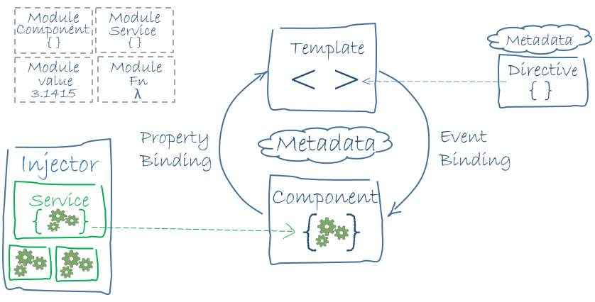
Angular2 Architecture
https://angular.io/docs/ts/latest/guide/architecture.html

Slide 18
Angular2 Architecture
Application = Tree of Components
Properties
Events
Service A
Component
Component
Component
Service B
vice
Component
Component
Component
Component
Component
Component

Slide 19

Observables - RxJS
What are they?
Asynchronous event streams
Replaces promises
Convertible to a promises
Cold until “subscribe” is called
What do we get that promises didn’t have?
Cancellable
Multiple events
Multiple subscribers
Event streams can be manipulated: ex debounce

Slide 20
Hardest problem in any relationship?
Deciding what to eat.

Slide 21
Code

Slide 22

Wait, what happened to…
Controllers, Factories
$scope, $rootScope
ng-click, ng-show, ng-doThatThing…
$broadcast, $emit, $on
MVC

Slide 23
Bindings
[property] property binding
(event) event binding
[(two-way)] two way binding <- Banana in a Box/Hot Dog in a Bun
Example: Receipt Input Component

Slide 24
Parent-Child Component Communication
@Output: creates event emiters that the parent can listen for
Child Syntax
@Output() customEventName = new EventEmiter();
customEventName.emit({“emitted”:”Up to the parent”});
Parent Syntax
<child (customEventName) = “parentFunctionToCall($event )”></child>
@Input()
Parent Syntax
<child [customObject] = “{passed: ’down to child’} ”></child>
Child Syntax
@Input() customObject;
@Input(‘customObject’) customChild;
Smart vs Dumb Components
Receipt Manager & Receipt List

Slide 25
Services, Pipes & Routing
Services
Location for abstracting business L
Replace Services, Factories & Providers from Angular 1.x
@Injectable() decorator
Pipes
Replace Filters
Several filters no longer default in pipes like orderBy. Angular2 team is relying on the community add these modules
Async filter understands Observables and Promises natively
Routing
Rewritten for RC2 which was released 6/15/16
Child routes in default router
No hash routing. Server routes look the same as client side routes.
http://victorsavkin.com/post/145672529346/angular-router

Slide 26
Testing
Jasmine is baked into Angular2
Karma Unit test runner
Protractor for end to end testing
Wrapper Around Selenium
With the CLI – (server needs to de running)
ng e2e
ng test –build=false
Prevents broccoli compiler error

Slide 27
Modules need a loader…so use one
Loads Script Dependencies
Resolves import statements and allow modules to be loaded
Bundle -> Minify and combine application scripts
Code Splitting -> Lazy loading scripts, allows browsers to understand module syntax. (similar to requireJS)
Options
WebPack – Used by AngularCLI, popular module loader, also “Angular Approved”
SystemJS - Angular Examples
Combine and Minify JS through other means (Gulp/Grunt)

Slide 28
Resources – Angular & TypeScript
Angular Docs
https://angular.io/docs/ts/latest
TypeScript Docs
https://www.typescriptlang.org/
Angular CLI
https://github.com/angular/angular-cli

